Slide 2
Fundamentals of Windows Containers and Windows Container—Based Web Apps on Azure App Service
BRK2045
Andrew Westgarth
Senior Program Manager
Azure App Service
@apwestgarth

Slide 3

Andrew Westgarth
Senior Program Manager @ Microsoft
Azure/App service/Azure functions
https://blogs.msdn.microsoft.com/appserviceteam
@apwestgarth
andrew.westgarth@microsoft.com

Slide 4
Azure App Service
Quickly build, deploy, and scale powerful cloud applications without worrying about infrastructure
High productivity
Fully managed
Enterprise grade
Accelerate development using existing language skills, familiar frameworks, built-in CI/CD, and intelligent diagnostic capabilities
Focus on application logic and let Azure take care of mundane tasks like capacity provisioning, OS patching, scaling, load balancing, and domain management
Meet rigorous performance, security, and compliance requirements through a choice of hosting options, robust regulation support and MSI integration

Slide 5
Azure App Service
Quickly build, deploy, and scale powerful cloud applications without worrying about infrastructure
High productivity
.NET, Node, Java, Docker, PHP, Ruby, Python
Staging & deployment
Testing in production
App gallery marketplace
Fully managed
Auto scale & load balancing
High availability w/auto patching
Reduced operations costs
Backup & recovery
Enterprise grade
Global data center footprint
Hybrid support
AAD integration
Secure & compliance

Slide 6
>575K
>1.8M
>24B
Active customers
Apps & sites hosted
Requests per day

Slide 7
























575K active customers | 1.8M apps & sites hosted | >24B requests per day
Agriculture, forestry, and, fishing
Discrete manufacturing
Education
Government
Health
Hospitality and travel
Digital destination to support 20M hits and fuel more innovation
Get a new auction site up and running faster than ever
Azure App Services as a platform for modern apps
Self-help administration apps are hosted by Azure App Service on Azure Government
Turning a discovery into a marketable product easily
Use Azure App Service to rewrite its learning platform
Banking and capital markets
Crowdsourcing gets music from the cloud to the concert hall
Move solutions to Azure App Services and to explore product development in the cloud
Hong Kong’s largest pizza chain goes cloud and grabs a bigger slice of the market
Analyzes how kids learn, delivers 10x speed improvement
Developers take advantage of web app to boost innovation and savings
Highly scalable cloud service
Insurance
Non-profit
Media and cable
Power and utilities
Professional services
Retail and consumer goods
Back-end infrastructure includes Azure App Service integrated with Node.js
Canadian broadcaster delivers record-breaking online election coverage
Azure App Services tools to include worksheet data within Reactive
Big data and cloud technologies safeguard lives and businesses worldwide with Azure App Services
Insurance firm transforms online services
Azure App Service handles the dynamic resizing of images
Telecommunications
Process manufacturing and resource
Pioneer insurance model with speedy implementation
Serving the latest tech news to 2 million readers worldwide
Keeps tails wagging with help from Azure App Services
Azure App Services scale automatically for its consumer front end
Azure App Services cuts time-to-market by 40%
Transforms onboarding with Azure App Services

Slide 8
Windows containers on Azure App Service—scenarios
Lift and shift to PaaS
Application dependencies
Applications blocked by Sandbox limitations
Data center migration
.Net core applications

Slide 9


Web app for containers
Easily deploy and run container-based web apps at scale
Accelerated outer loop
Tight integration w/Docker Hub, Azure Container Registry
Built-in CI/CD w/ deployment slots
Intelligent diagnostics and troubleshooting, remote debugging
Fully managed platform
Automatic scaling and load balancing
High availability w/auto-patching
Backup and recovery
Flexibility & choices
From CLI, PS (Windows), portal, or ARM template
Single Docker image Linux only— multi container w/Docker compose, or Kubernetes pod definition
IntelliJ, Jenkins, Maven Visual Studio family

Slide 10
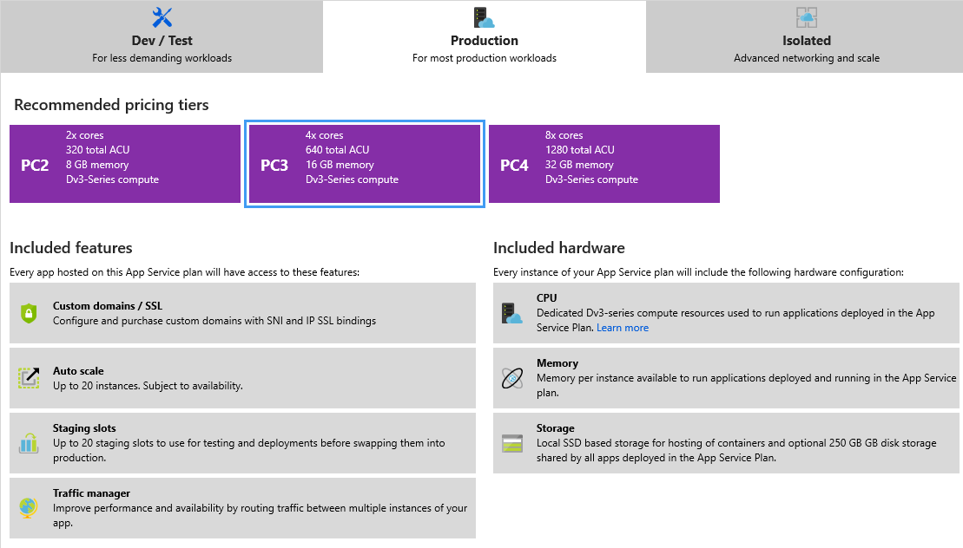
New SKU—Premium Container (PC)
PC2—D2v3
2 vCPU/8GB RAM/50GB SSD
PC3—D4v3
4 vCPU/16GB RAM/100GB SSD
PC4—D8v3
8 vCPU/32GB RAM/200GB SSD
EXCLUSIVE to Windows container apps

Slide 11
Cached base images
IIS
Repo | microsoft/iis
Server core image tag | windowsservercore-ltsc2016, latest
Nano image tag | nanoserver-sac2016
ASP.NET
Repo | microsoft/aspnet
Server core image tag | 4.7.2-windowsservercore-ltsc2016, 4.7.2, latest
ASP.NET core
Repo | microsoft/dotnet
Nano image tag | 2.1-aspnetcore-runtime
ASP.NET core build
Repo | microsoft/dotnet
Nano image tag | 2.1-sdk

Slide 12
Hello world—simple containerization of a web application
Andrew Westgarth

Slide 13
Demo review
Pre-requisites
Visual Studio 2017 with .Net core and Azure workloads installed
Docker for Windows
Docker Hub account or an Azure Container Registry
Example blog post—https://aka.ms/wincontonappsvchelloworld

Slide 14
Container customizations
Andrew Westgarth

Slide 15
Demo review
Demonstrated
Installation and use of custom font
PDF generation—often blocked by App Service sandbox
Installation and use of custom cultures
Installation and use GAC assemblies
Installation and calling native DLLs (*.msi installation package)

Slide 16
Windows remote management
Andrew Westgarth

Slide 17
Demo review
Configure Win-RM connection via portal/CLI*/PS
Open a remote PowerShell session directly into the deployed container

Slide 18
Build a CI/CD pipeline
Andrew Westgarth

Slide 19
Demo review
Take a .Net project
Create build pipeline
Take builds and create Docker images
Release via release pipeline to Azure Container Registry or Docker Hub
Enable CI/CD webhook in App Service
Deployment slots in App Service—slot swap

Slide 20
What is a container?
Traditional virtual machines = hardware virtualization
Hyper-V containers— Isolation plus performance
Application
VM
VM
VM
Container
Container
Container
OS
Kernel
Kernel
Kernel
Hardware
Hyper-V
Containers = operating system virtualization
Windows server containers— Maximum speed and density
Container
Container
Container
Container
Container
Container
Processes
Kernel
Kernel

Slide 21
Anatomy of a Windows container
Application code
Application layers
Pre-requisites | Customizations
Customization layers
App Service supports the long-term servicing channel of Windows Server 2016
Base OS—layer
i.e., Windows Server core 2016 LTSC | i.e., Windows Server Nano 2016 LTSC

Slide 22
Windows container best practices
Choose base image carefully
Core/Nano—LTSC/SAC
Choose cached images in order to benefit from speed of pull
Layers
Minimize image layers
Dockerfile optimizations—https://aka.ms/dockerfileoptimization
Image size
Group related actions
Remove excess files
Build speed
Multiple lines
Ordering of instructions
Cosmetic optimizations

Slide 23
Summary
Windows container support in Azure App Service in public preview
Offers new application modernization or migration possibilities
Key capabilities
Single Container
Deployment Slots
Continuous Integration\Deployment
Easy Authentication
Scale
Windows remote Management
New powerful SKUs

Slide 24
Q&A

Slide 25
Check out more App Service sessions at #MSIgnite!
Session title | Code | Time | Speaker
Your web apps from code to deployed in a minute! | THR1110 | Monday, 12:45–1:05 | Nick King
Best practices for mission critical apps on Azure App Service | THR3105 | Monday, 1:20–1:40 | Stefan Schackow
Oops, I deleted my web app! What now? | THR2204 | Monday, 5:45–6:05 | Nick King
What is new in Azure App Service networking | BRK2386 | Tuesday, 2:00–2:45 | Christina Compy
Fundamentals of Windows containers and Windows container-based web apps on Azure App Service | BRK2045 | Tuesday, 2:15–3:30 | Andrew Westgarth
Keep your PaaS and serverless apps healthy and happy | BRK3344 | Tuesday, 4:30–5:15 | Jennifer Lee
Bring your container or code to easily deploy to App Service on Linux | BRK2390 | Friday, 12:30–1:45 | Jennifer Lee Jenny Lawrance

Slide 26
Please evaluate this session Your feedback is important to us!
Please evaluate this session through MyEvaluations on the mobile app or website.
Download the app: https://aka.ms/ignite.mobileApp
Go to the website: https://myignite.techcommunity.microsoft.com/evaluations

Slide 28
Text layout (without bullet points)
Main topic: Segoe UI Semilight, size 28pt
Segoe UI, size 20pt for second level
Segoe UI, size 16pt for third level

Slide 29
Text layout with bulleted text
Main topic: Segoe UI Semilight, size 28pt
Segoe UI, size 20pt for second level
Segoe UI, size 16pt for third level

Slide 30
Example with longer headline text wrapping to a second line
When the headline text is 2 lines, move this text block down to align to the lower blue guide
If you don’t see guidelines, click on the View menu, and then check the box in front of “Guides”
Use a “soft return” Shift + Enter to wrap text without adding extra line spacing

Slide 31
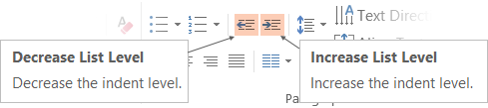
Adjusting list levels
Main topic: Segoe UI Semilight, size 28pt
Segoe UI, size 20pt for second level
Segoe UI, size 16pt for third level
Use the “Decrease List Level” and “Increase List Level” tools on the Home menu to change text levels.
Try this:
Place your cursor in the line of text that says “Segoe UI, size 20pt for second level”
Next click the Home tab, and then on the “Decrease List level” tool. Notice how the line moves up one level.
Now try placing your cursor in one of the top “Main topic…” line of text. Click the “Increase List Level” tool and see how the text is pushed in one level.
Use these 2 tools to adjust your text levels as you work

Slide 32
Bullet points layout with subtitle Set the subtitle to 20pt in the same text block, with character spacing Normal
Move the text block down vertically to align to lower guide
If you don’t see guidelines, click on the View menu, and then check the box in front of “Guides”
Hyperlink style: www.microsoft.com

Slide 33
Enter title text
Secondary text

Slide 34
Square photo layout with body text

Slide 35
Slide palette info
The PowerPoint palette for this template has been built for you and is shown below.
Avoid using too many colors in your presentation.
PowerPoint Theme Accent colors
Accent 1
Accent 2
Accent 3
Accent 4
Accent 5
Accent 6
Use Accent 1 as the main accent color.
Use Accent 2 and Accent 3 only when additional colors are needed.
Use Accents 4-6 sparingly

Slide 36
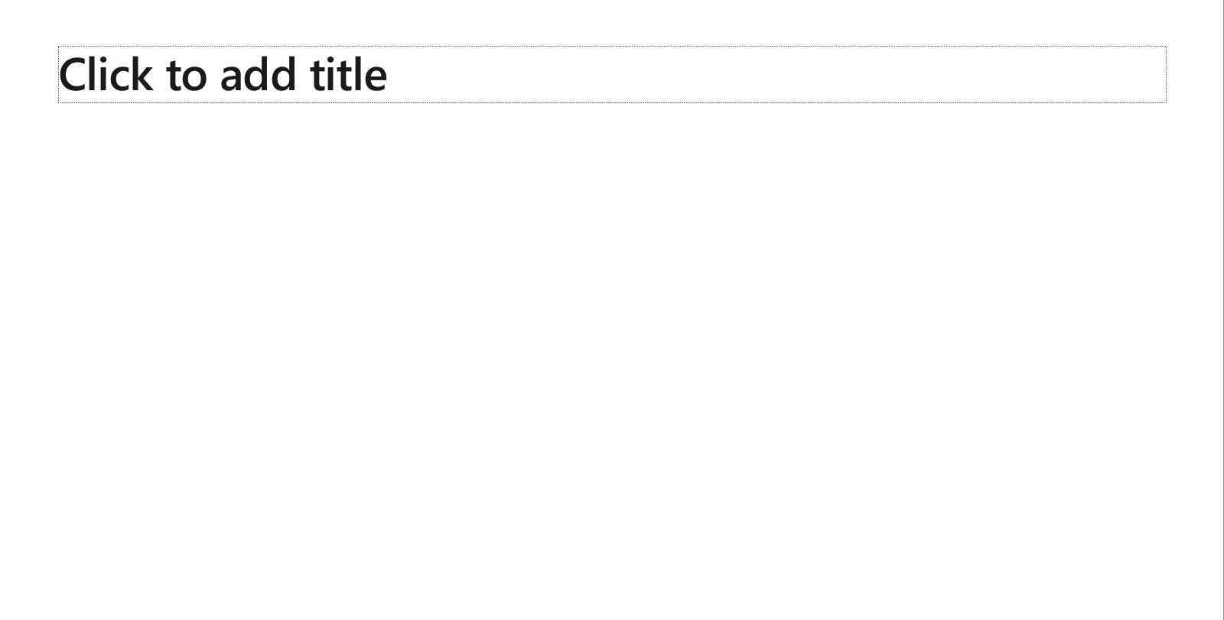
Creating accessible content
Take the following steps to create accessible content that everyone can consume effectively.
Contrast
Use high contrast colors for maximum readability
The recommended contrast ratio is at least 4.5:1
Shape and color
Use different shapes with a legend to indicate statuses to accommodate for color blindness
Example:
Alt text
Alt text helps people with screen readers understand the content of slides
You can create alternative text for shapes, pictures, charts, tables, SmartArt graphics, or other objects
Here’s how:
Right click the image or shape
Select Format Picture… or Format Shape…
Select the Size & Properties icon
Expand the Alt Text field
Enter a Title and Description of your image or object
Slide layouts
Using a built-in slide layout that matches your content ensures a hierarchical reading order of text blocks
Example:
If a new slide will have a title, rather than starting with a blank layout and adding a text block for the title, choose one of the built-in layouts with a title placeholder
Reading order
Screen readers describe content on the screen in the order it was created
To ensure your content is read back in the order you prefer, arrange your objects in the Selection Pane appropriately. Objects on the bottom of the selection pane are read first
Here’s how:
Click the Home tab
In the Drawing group, select the Arrange drop-down menu
Click Selection Pane…
Text
Text
Text
Subject 1
Subject 2
Subject 3
Color Contrast Analyzer
Download this tool to determine the legibility of text and the contrast of visual elements
Download
C1
C2
C3
Additional tips
Be sure to run the Accessibility Checker! Go to File click the Check for Issues drop down menu click Check Accessibility
Videos need to be accessible: If your presentation includes a video, ensure it is captioned and audio described (if appropriate)
Visit the Office Accessibility Center to learn more about accessibility in PowerPoint

Slide 37
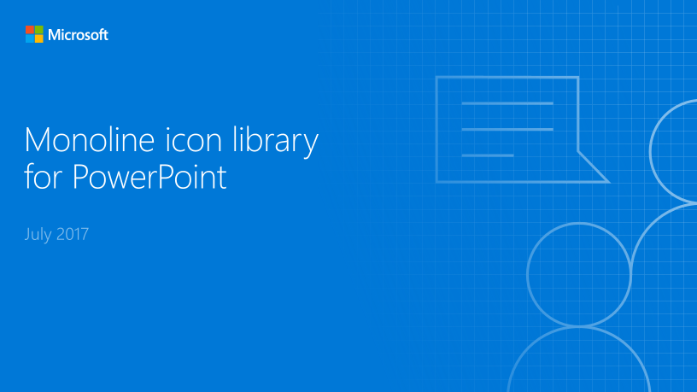
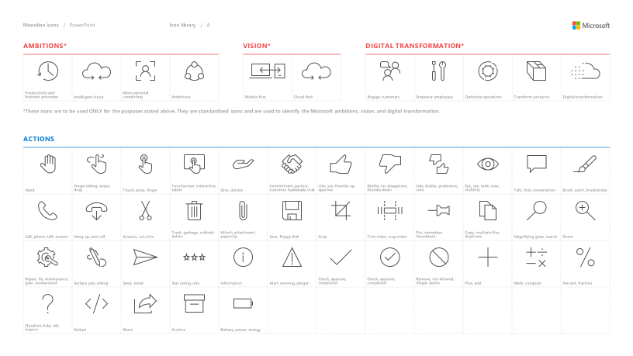
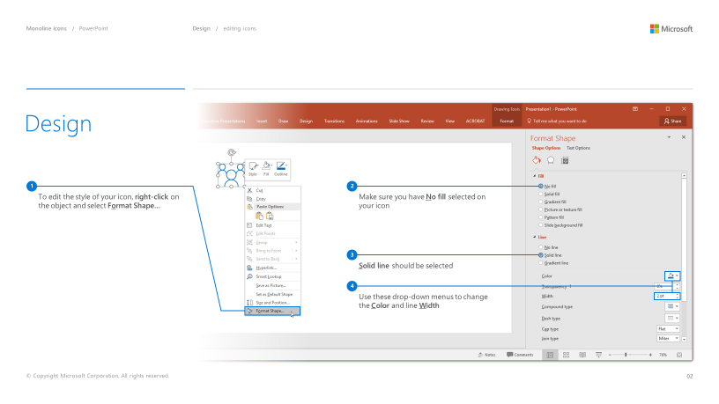
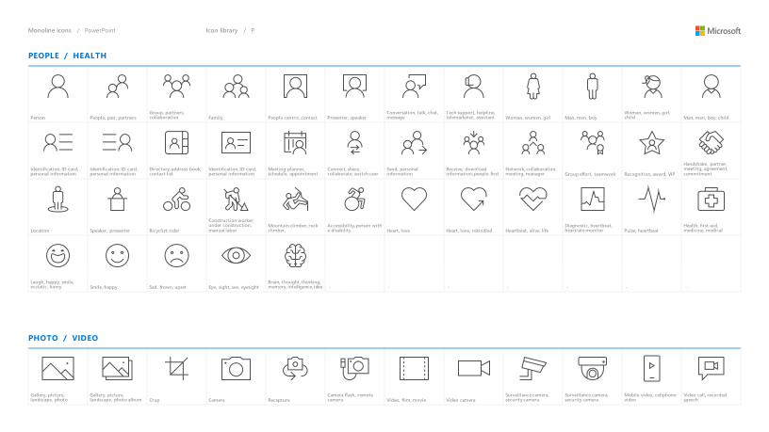
Microsoft monoline icons
Looking for icon resources?
The Monoline icon library for PowerPoint is a slide deck that provides a library of icons for use in PowerPoint presentations.
The Monoline icon style guide for PowerPoint is a pdf with additional guidelines.
Download both from Brand Central.

Slide 38
Demo
Speaker name

Slide 39
Video

Slide 40
Section title

Slide 41
Software code slide
This slide layout uses Consolas, a monotype font which is ideal for showing software code.

